Slide 1
Introduction to Usability, UX, and Design
Lecture 2

Slide 2
Usability

Slide 3
Usability – Nielsen-Norman definition
Definition of Usability
Usability is a quality attribute that assesses how easy user interfaces (or any other products or services) are to use. The word "usability" also refers to methods for improving ease-of-use during the design process
Usability is defined by 5 quality components:
Learnability: How easy is it for users to accomplish basic tasks the first time they encounter the design?
Efficiency: Once users have learned the design, how quickly can they perform tasks?
Memorability: When users return to the design after a period of not using it, how easily can they reestablish proficiency?
Errors: How many errors do users make, how severe are these errors, and how easily can they recover from the errors?
Satisfaction: How pleasant is it to use the design?
(Jakob Nielsen, Don Norman - https://www.nngroup.com/articles/usability-101-introduction-to-usability/)

Slide 4
Usability - ISO Definition
"The extent to which a product can be used by specified users to achieve specified goals with effectiveness, efficiency, and satisfaction in a specified context of use."

Slide 5
Usability and Utility
There are many other important quality attributes. A key one is utility, which refers to the design's functionality: Does it do what users need?
Usability and utility are equally important and together determine whether something is useful: It matters little that something is easy if it's not what you want. It's also no good if the system can hypothetically do what you want, but you can't make it happen because the user interface is too difficult. To study a design's utility, you can use the same user research methods that improve usability.

Slide 6
Usability and Utility (cont.)
Definition of Utility = whether it provides the features you need.
Definition of Usability = how easy & pleasant these features are to use.
Definition of Useful = usability + utility.

Slide 7
Usability motivations
Life-critical systems
Air traffic control, nuclear reactors, power utilities, police & fire dispatch systems, medical equipment
High costs, safety, reliability and effectiveness are expected
Lengthy training periods are acceptable despite the financial cost, to provide error-free performance and avoid the low frequency but high cost errors
Subject satisfaction is less an issue due to well motivated users

Slide 8
Usability motivations (cont.)
Office, home, and entertainment applications
Word processing, e-mail, video conferencing, and video game systems, educational packages, search engines, mobile device, etc.
Ease of learning, low error rates, and subjective satisfaction are paramount, since use is often discretionary and the competition is fierce
Infrequent use of some applications means interfaces must be intuitive, and easy to use help sections are important
Choosing functionality is difficult because the population has a wide range of both novice and expert users
Competition cause the need for low cost
Notes:
New games and gaming devices
E.g. Nintendo Wii

Slide 9
User Experience

Slide 10
User Experience
Don Norman’s explanation:
https://www.youtube.com/watch?v=9BdtGjoIN4E

Slide 11
User Experience
“Every aspect of the user’s interaction with a product, service, or company that make up the user’s perceptions of the whole. User experience design as a discipline is concerned with all the elements that together make up that interface, including layout, visual design, text, brand, sound, and interaction.”
User Experience Professionals Association (UXPA)

Slide 12
User Experience
“User experience (UX) focuses on having a deep understanding of users, what they need, what they value, their abilities, and also their limitations. It also takes into account the business goals and objectives of the group managing the project. UX best practices promote improving the quality of the user’s interaction with and perceptions of your product and any related services.”
Usability.gov

Slide 13
Usability vs. User Experience

Slide 14
Usability Goals
Effective to use
Efficient to use
Easy to learn
Easy to remember how to use
Safe to use (little to no errors, no severe errors, easy to recover)

Slide 15
User Experience goals
Desirable aspects
satisfying helpful fun
enjoyable motivating provocative
engaging challenging surprising
pleasurable enhancing sociability rewarding
exciting supporting creativity emotionally fulfilling
entertaining cognitively stimulating
Undesirable aspects
boring unpleasant
frustrating patronizing
making one feel guilty making one feel stupid
annoying cutesy
childish gimmicky

Slide 16
User-friendly?

Slide 17
“User-friendly”
Synonyms for “user-friendly” in Microsoft Word are easy to use; accessible; comprehensible; intelligible; idiot proof; available; and ready
But a “friend” also seeks to help and be valuable. A friend is not only understandable, but understands. A friend is reliable. A friend is pleasant to be with.
These measures are subjective and vague

Slide 18
HCI/Usability/UX in industry

Slide 19
HCI/Usability/UX in industry
Increasing number of consultancies, examples of well known ones include:
Nielsen Norman Group: “help companies enter the age of the consumer, designing human-centered products and services”
Cooper: “From research and product to goal-related design”
Swim: “provides a wide range of design services, in each case targeted to address the product development needs at hand”
IDEO: “creates products, services and environments for companies pioneering new ways to provide value to their customers”

Slide 20
HCI/Usability/UX in industry
interaction designers - people involved in the design of all the interactive aspects of a product (previously called UI designers)
web designers - people who develop and create the visual design of websites, such as layouts
information architects - people who come up with ideas of how to plan and structure interactive products (e.g. websites)
user experience designers/researchers (UX) - people who do all the above but who may also carry out field studies to inform the design of products
usability engineers - people who focus on evaluating products, using usability methods and principles

Slide 21
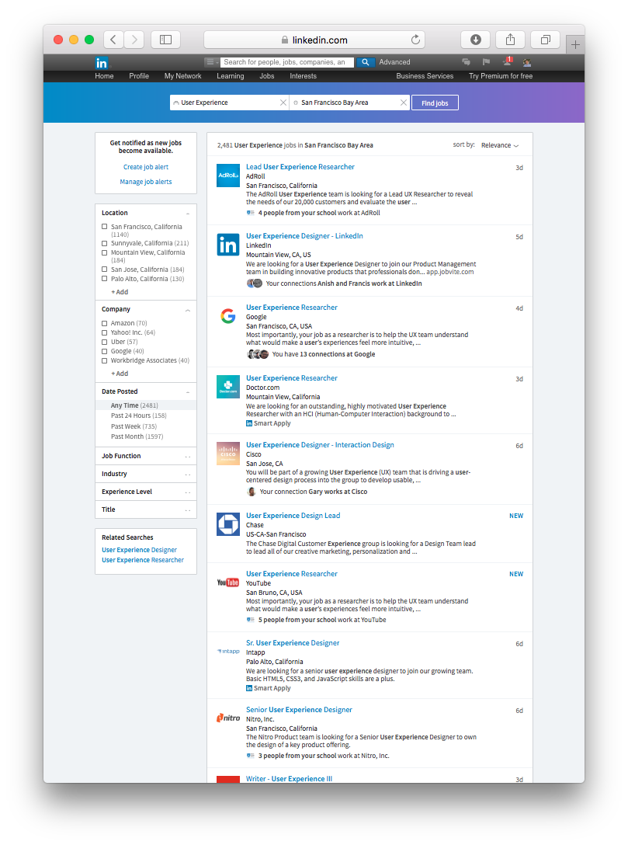

Slide 22

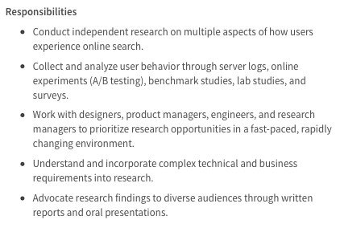

Slide 23
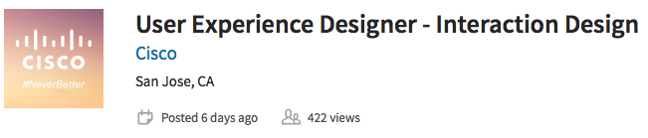
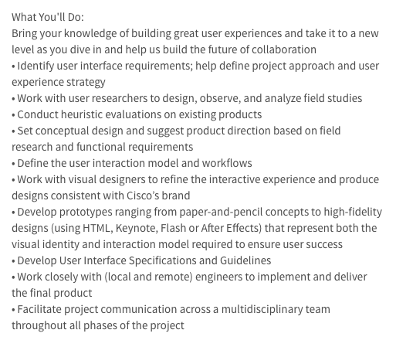

Slide 24
Universal Usability

Slide 25
Universal Usability
“There is no average user, either compromises must be made or multiple versions of a system must be created”
Ben Shneiderman

Slide 26
Universal Usability (cont.)
Physical abilities
Vision: depth, contrast, color blindness, and motion sensitivity
Touch: keyboard and touchscreen sensitivity
Hearing: audio clues must be distinct
Movement
…

Slide 27
Universal Usability (cont.)
Cognitive and perceptual abilities
The human ability to interpret sensory input rapidly and to initiate complex actions makes modern computer systems possible
The journal Ergonomics Abstracts offers this classification of human cognitive processes:
Long-term and semantic memory
Short-term/working memory
Problem solving and reasoning
Decision making and risk assessment
Language communication and comprehension
Search, imagery, and sensory memory
Learning, skill development, knowledge acquisition, and concept attainment

Slide 28
Universal Usability (cont.)
Personality differences
There is no set taxonomy for identifying user personality types
Designers must be aware that populations are subdivided and that these subdivisions have various responses to different stimuli
Myers-Briggs Type Indicator (MBTI)
extroversion versus introversion
sensing versus intuition
perceptive versus judging
feeling versus thinking

Slide 29
Universal Usability (cont.)
Users with physical challenges
Designers must plan early to accommodate users with disabilities
Early planning is more cost efficient than adding on later
Businesses must comply with the "Americans With Disabilities" Act for some applications – applies to Websites!
Older Adult Users
Designers should allow for variability within their applications via settings for sound, color, brightness, font sizes, etc. with less distracting animation

Slide 30
Universal Usability (cont.)
Cultural and international diversity
Characters, numerals, special characters, and diacritics
Left-to-right versus right-to-left versus vertical input and reading
Date and time formats
Numeric and currency formats
Weights and measures
Telephone numbers and addresses
Names and titles (Mr., Ms., Mme.)
Social-security, national identification, and passport numbers
Capitalization and punctuation
Sorting sequences
Icons, buttons, colors
Pluralization, grammar, spelling
Etiquette, policies, tone, formality, metaphors

Slide 31
Universal Usability (cont.)
Additional factors affecting perceptual and motor performance:
Fatigue and sleep deprivation
Arousal and vigilance
Perceptual (mental) load
Knowledge of results and feedback
Monotony and boredom
Sensory deprivation
Nutrition and diet
Fear, anxiety, mood, and emotion
Drugs, smoking, and alcohol
Physiological rhythms
But note, in any application, background experience and knowledge in the task domain and the interface domain play key roles in learning and performance

Slide 32
Design

Slide 33
Design is a process
Establishing requirements
Developing alternatives/Prototyping
Evaluating

Slide 34
What to design?
Need to take into account:
Who the users are
What activities are being carried out
Where the interaction is taking place
Need to optimize the interactions users have with a product:
So that they match the users’ activities and needs

Slide 35
Core characteristics of good design
Users should be involved through the development of the project
Specific usability and user experience goals need to be identified, clearly documented and agreed at the beginning of the project
Iteration is needed through the core activities

Slide 36
Understanding users’ needs
Need to take into account what people are good and bad at
Consider what might help people in the way they currently do things
Think through what might provide quality user experiences
Listen to what people want and get them involved
Use tried and tested user-centered methods

Slide 37
Why go to this length?
Help designers:
understand how to design interactive products that fit with what people want, need and may desire
appreciate that one size does not fit all
e.g., teenagers are very different to “grown-ups”
identify any incorrect assumptions they may have about particular user groups
e.g., not all old people want or need big fonts
be aware of both people’s sensitivities and their capabilities

Slide 38
Relation to software engineering
Similar to architects vs. civil engineers, e.g. problem of building a house.
Architects
concerned with the people
interactions with each other
Interactions with the house being built
E.g. right mix of family and private spaces?
E.g. Are the spaces for cooking and eating in close proximity?
E.g. Will people live in the space being designed in the way it was intended to be used?
Civil engineers
issues to do with realizing the project.
practical concerns
E.g. cost, durability, structural aspects, environmental aspects, fire regulations, and construction methods.

Slide 39
Design means working in multidisciplinary teams
Many people from different backgrounds involved
Different perspectives and ways of seeing and talking about things
Benefits
more ideas and designs generated
Disadvantages
difficult to communicate and progress forward the designs being create

Slide 40
Question
Who do you think should be involved in developing:
A public kiosk providing information about the exhibits available in a science museum?
An interactive educational website to accompany a TV series?

Slide 41
Sample Answers
Ideally, each team will have a number of different people with different skill sets.
The first interactive product would include:
Graphic and interaction designers
museum curators
educational advisers
software engineers
Ergonomists
The second project would include:
TV producers
graphic and interaction designers
Teachers
video experts
software engineers
In addition, as both systems are being developed for use by the general public, representative users should be involved.
School children
Parents

